Slide 1
Data Flow Diagrams

Slide 2
What is a Data Flow Diagram?
A data flow diagram (DFD) is a graphical representation of the movement of data between external entities, processes and data stores within a system.
Simply put, DFD’s show how data moves through an information system.

Slide 3
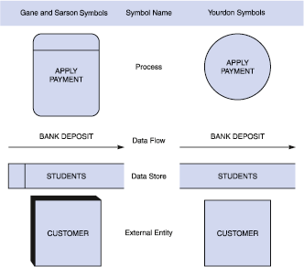
DFD Symbols

Slide 4
Process
The work or actions performed on data so that they are transformed, stored, or distributed.
Process labels should be verb phrases!

Slide 5
Data Flow
A path for data to move from one part of the system to another.
Data in motion!
Arrows depict the movement of data.
NO VERBS

Slide 6
Data Store
Used in a DFD to represent data that the system stores
Data at rest!
Labels should be noun phrases
(NO VERBS)

Slide 7
External Entity aka Source/Sink
The origin or destination of data!
This represents things outside of the system.
Source – Entity that supplies data to the system.
Sink – Entity that receives data from the system.
The labels should be noun phrases!

Slide 8
General DFD Rules
YES
NO
A process to another process
A process to an external entity
A process to a data store
An external entity to another external entity
An external entity to a data store
A data store to another data store

Slide 9
Advantages of DFDs
Simple graphical techniques which are easy to understand
Helps define the boundaries of the system
Useful for communicating current system knowledge to users
Explains the logic behind the data flow within the system
Used as the part of system documentation file
Rottman makes you do these in design!

